Slide 1
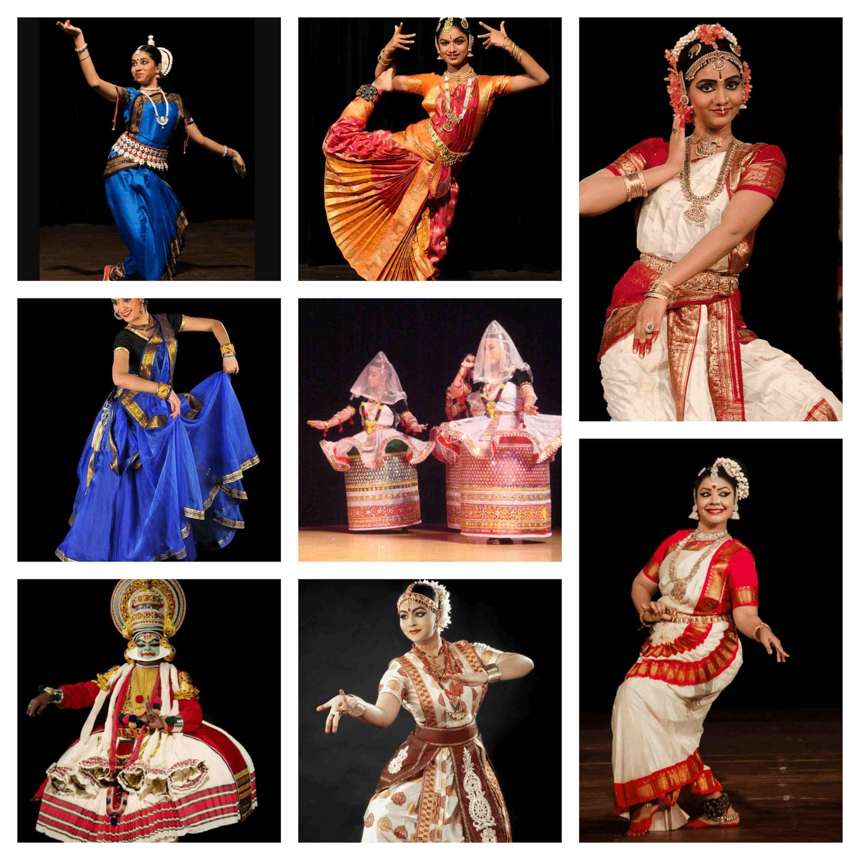
Satyapriya Roy College of Education
Course-EPC-2 (1.2EPC2)
DRAMA AND ARTS IN EDUCATION
Prepare a pictorial monograph on "Various Dance forms in India“
NAME: AHANA BANERJEE
COLLEGE ROLL NO.: B/22
REGISTRATION NO.: 2011002002 of 2020-21
CLASS: B.ED, SEMESTER II
SESSION: 2020-2022

Slide 2
INTRODUCTION
India has many dances, coming from every state in the country, although there are only six
forms of the classical dances recognised by India on a national level. They are
Bharatnatyam, Kathak, Kathakali, Manipuri, Kuchipudi, and Odissi. The folk dances of India
are much more than mere body movements, from the very ancient times the classical
dance forms of India is considered as a discipline and a way to devote yourself to God
through art.
The main 7 types of classical dances of India are discussed here which are:
Bharatanatyam
Kathak
Kathakali
Manipuri
Odissi
Mohininatyam
Kuchupudi

Slide 3
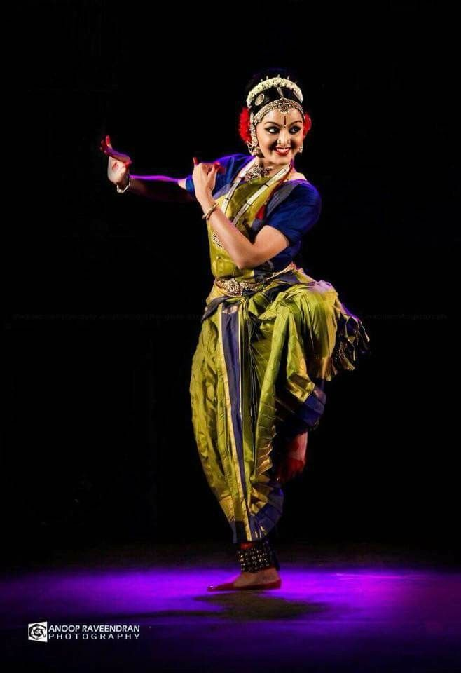
BHARATANATYAM
HISTORY
Performed on the celestial tunes of the Carnatic music, Bharatanatyam comes from the state of Tamil Nadu in South.
The origins of Bharatanatyam can be traced back to 1000 BC, and it originates from the ancient temples of Tamil Nadu performed by the women of the classical period.
COSTUMES :
Generally, the costumes of Bharatanatyam
have two types. They are Pyjama style and
another skirt style. The costumes of
Bharatanatyam are prepared by stitching
embroidery with different religious motifs and
designs.Bharatanatyam costumes for women
resemble Indian traditional sari. But the sari is
not a single piece; it is the combination of
many varieties of cloth piece. The color of the
costumes is very bright and attractive.
Notes:
.

Slide 4
The traditional Bharatanatyam costume for men is very simple. The dress
covers the lower body of the dancer and upper part cover with a simple
jewel, do not use the garments for the upper part of the male dancer. The
dhoti stitched with rich embroidery and silk threads use to stitch to farm
the designs on dhoti.
MAKEUP:
Makeup to a Bharatanatyam dancer is very unique, should display the theme of the dance on face movements. Heavy lines are drawn around the eyes and darken and extended outwards the eyebrows. The total Bharatanatyam performance is mostly based on the movements of the eyes and eyebrows. So eyebrows decorate to visual the movements clearly, then the spectators easily attach to the dance. A red dye applied to the tips of the toes, fingertips, and soles of the feet. The color also applied in the palm in a solid circle. The red color decoration to legs and hands emphasize the movements of hands and legs.

Slide 5
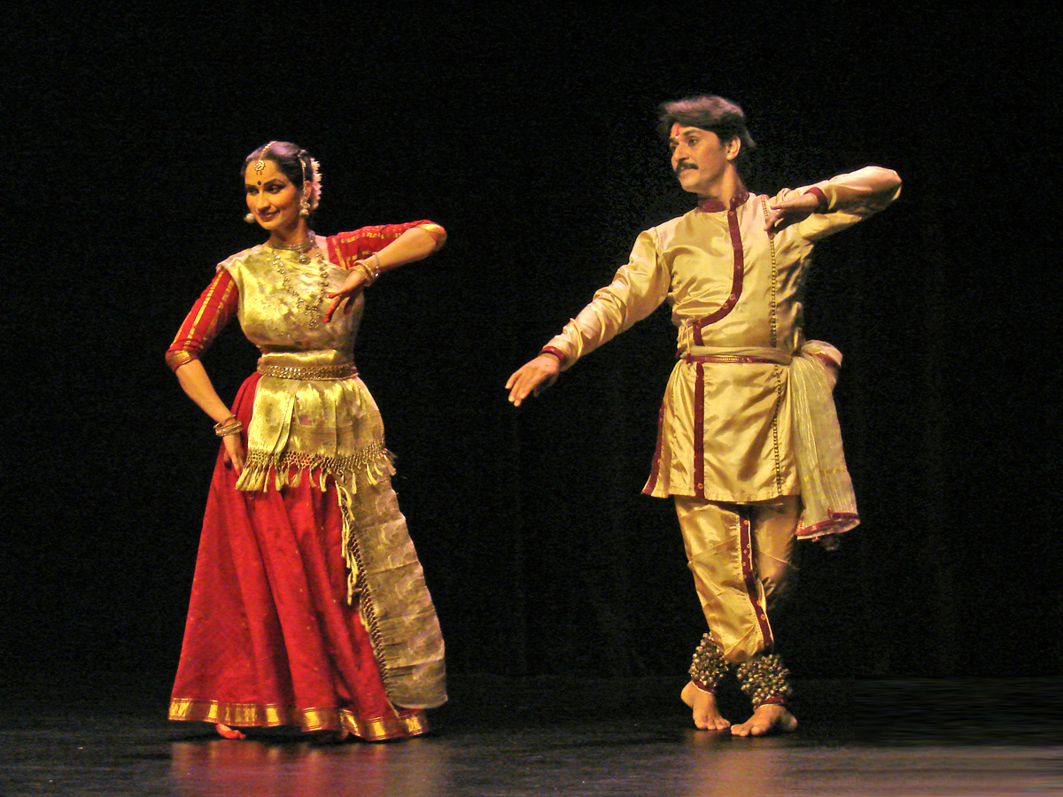
KATHAK
Kathak is one of the main genres of ancient
Indian classical dance and is traditionally
regarded to have originated from the
travelling bards of North India referred as
Kathakars or storytellers.
HISTORY:
The word Kathak is deduced from the
Vedic Sanskrit term‘Katha’ which means
‘story’ while the term kathaka that finds
place in several Hindu epics and texts
means the person who tells a story. According
to‘Natya Shastra’ written by ancient
Indian theatrologist and musicologist
Bharata Muni, the first complete version of
the text was completed between 200 BCE to
200 CE, but some sources mention the
timeframe to be around 500 BCE and
500CE.
.

Slide 6
COSTUMES AND JWELERY:
As Kathak is popular both in Hindu and Muslim communities the costumes of this dance form are made in line with traditions of the respective communities. There are two types of Hindu costumes for female dancers. While the first one includes a sari worn in a unique fashion complimented with a choli or blouse that covers the upper body and a scarf or urhni worn in some places, the other costume includes a long embroidered skirt with a contrasting choli and a transparent urhni. Costume is well complimented with traditional jewellery, usually gold, that includes the ones adorning her hair, nose, ear, neck and hand. Musical anklets called ghunghru made of leather straps with small metallic bells attached to it are wrapped in her ankles that produce rhythmic sound while she performs excellent and spectacular
footwork. Hindu male Kathak dancers usually wear a silk dhoti with a silk scarf tied on the upper part of the body which usually remain bare or may be covered by a loose jacket. Jewellery of male dancers is quite simple compared to their female counterparts and are usually made of stone.
The costume for Muslim female dancers includes a skirt along with a tight fitting trouser called churidar or pyjama and a long coat to cover the upper body and hands. A scarf covering the head compliments the whole attire which is completed with light jewellery.
MAKEUP:
Vivid face make-up put on helps highlight the facial expressions.

Slide 7
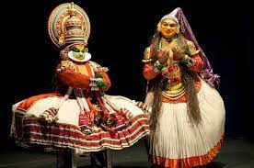
KATHAKLI
Kathakali’, an important genre in the Indian
classical dance form, is associated with
storytelling form of this art. It is the dance
drama from the south Indian state of Kerala.
HISTORY
Elements and aspects of Kathakalī are taken
from ancient Sanskrit texts such as the Natya
Shastra. The kathakali is attributed to
sage Bharata and its first complete
compilation is dated to between 200 BCE and
200 CE, but estimates vary between 500 BCE
and 500 CE.

Slide 8
MAKEUP
The costume is elaborate andthe faceis painted in vivid hues. The Vesham or makeup is of five types - Pacha, Kathi, Thadi, Kari and Minukku.
The pomp and magnificence of Kathakali is partly due to its décor, part of which is the kireetam (huge ornamental headgear) and the kanchukam (over sized jackets), and a long skirt worn over a thick padding of cushions. The artists completely immerse themselves and the audience into the story they're describing.
Pacha (Green)
Pacha Vesham or the green make-up portrays noble protagonists.
Kathi (Knife)
Kathi Vesham portrays villainous characters.
Thadi (Beard)
There are three types of beards or Thadi Veshams. VellaThadi or White beard for superhuman monkeys like Hanuman. ChuvannaThadi or Red beard meant for evil characters. KaruthaThadi or Black beard for the hunter.
Kari (Black)
Kari Vesham is used for she-demons
Minukku (Prettying Up)
The "Minukku Vesham" is used for female characters and sages.

Slide 9
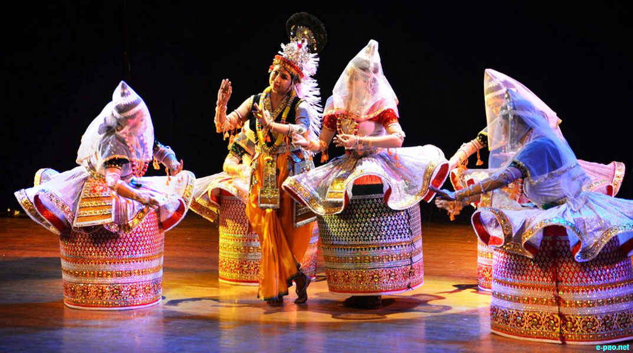
MANIPURI
Manipuri dance is counted among major
classical dance forms of India, especially
noted for themes based on Vaishnavism
and spectacular execution of ‘Ras Lila’,
dance dramas based on love between
Radha and Krishna.
Other themes included in this art form
associate with Shaktism, Shaivism and on
the sylvan deities called Umang Lai
during Manipuri festival ‘Lai Haraoba’.
This dance form is named after the
north-eastern state of Manipur, India
from where it originated but it has its
roots in ‘Natya Shastra’.
HISTORY:
The first reliably dated written texts describing the
art of Manipuri dance are from the early 18th-
century.

Slide 10
COSTUMES:
The costumes for Manipuri dancers, particularly for women are quite unique from other Indian classical dance forms. A male dancer wears a bright coloured dhoti, also referred as dhora or dhotra that covers lower part of his body from waist. The unique style of wearing it gives the dancer the flexibility to perform his footwork. A crown decorated with peacock feather adorns the dancer’s head, who portrays the character of Lord Krishna.
The costume of female dancers resembles that of a Manipuri bride, referred as Potloi costumes. The most distinguished of these is the Kumil costume that is an exquisitely embellished long skirt in the shape of a barrel with a stiffened bottom. The skirt is embroidered with fine gold and silver works decorated with small mirror pieces and designs of lotus and other natural items as border prints. The top border of Kumil adorns a wavy and translucent fine skirt tied in three places around the waist in Trikasta and opens up like a flower. A velvet choli or blouse adorns the upper part of the body and a translucent veil white in colour covers the head. The dancer wears round shaped jewellery or garlands of flowers to adorn her face, hand, neck, waist and legs that synchronize well with her costume. A Manipuri dancer does not wear a ghunghroo.

Slide 11
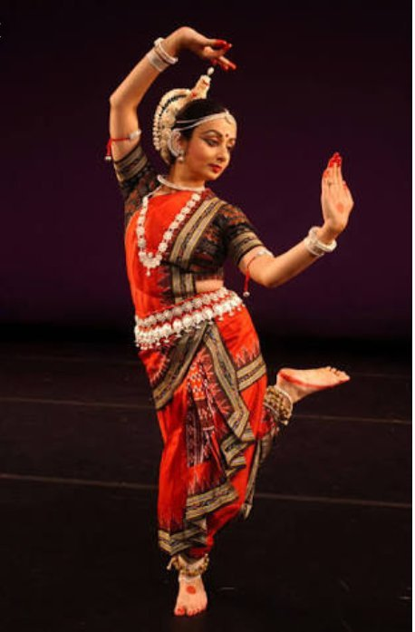
ODISSI
Odissi or Orissi is one of the pre-eminent classical
dance forms of India which originated in the
Hindu temples of the eastern coastal state of
Odisha in India. Age-old tradition of Odissi is
manifested from Odisha Hindu
temples and various sites of archaeological
significance that are associated with Hinduism,
Jainism and Buddhism, the sculptures of which
adorn dance postures of this art form.
HISTORY
The origins of this dance can be traced
back to the 2nd century B.C. carvings of
the Rani Gumpa caves in Udaygiri,
Odisha. The Natya Shastra refers to this
dance as Odar Magadha. It is considered
to be one of the oldest dances in the
world.

Slide 12
COSTUMES
The female dancers wear brightly coloured sari usually made of local silk adorned with traditional and local designs such as the Bomkai Saree and the Sambalpuri Saree. The front part of the sari is worn with pleats or a separate pleated cloth stitched in front to ensure flexibility of movements of the dancer while showcasing excellent footwork. Silver Jewellery adorns her head, ear, neck, arms and wrists.
Musical anklets called ghunghru made of leather straps with small metallic bells attached to it are wrapped in her ankles while her waist is tied with an elaborate belt. Her feet and palms are brightened
with red coloured dyes called alta. She wears a tikka on forehead and outlines her eyes prominently with Kajal so as to make her eye movements more visible. Her hair is tied in a bun and beautified with
Seenthi. A moon shaped crest of white flowers or a Mukoot that is a reed crown with peacock feathers symbolising Lord Krishna may adorn the hairdo.
A male dancer wears a dhoti neatly pleated in the front and tucked between the legs that cover his lower body from waist while the upper body remains bare. A belt adorns his waist.

Slide 13
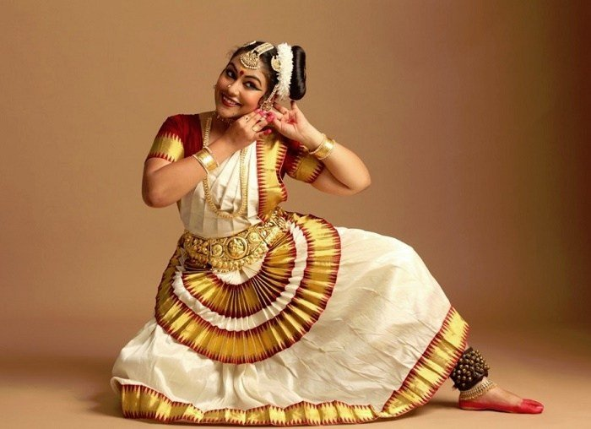
MOHINIYATTAM
Mohiniyattam literally interpreted as the dance
of ‘Mohini’, thecelestial enchantress of the Hindu
mythology, is the classical solo dance form of
Kerala.
History
References of Mohiniyattam can be found in the texts Vyavaharamala written in 1709 by Mazhamagalam Narayanan Namputiri and in Ghoshayatra, written later by great poet Kunjan Nambiar.
This dance form of Kerala was structured into the present day classical format by the Travancore Kings, Maharaja KartikaTirunal and his successor Maharaja Swati Tirunal (18th -19th century C.E.).

Slide 14
CHARACTERISTICS:
Mohiniyattam is characterized by graceful, swaying body movements with no abrupt jerks or sudden leaps. It belongs to the lasya style which is feminine, tender and graceful.
The movements are emphasized by the glides and the up and down movement on toes.
The foot work is not terse and is rendered softly.
Mohiniyattam lays emphasis on acting. The dancer identifies herself with the character and sentiments existing in the compositions like the Padams and Pada Varnams which give ample opportunity for facial expressions
COSTUMES:
The Mohiniyattam Dance Dress is an off-white plain saree, embellished with a gold-laced or bright golden-colored brocade, embroidered on the borders. A matching blouse finishes the adornment. The front part of the saree has a pleated cloth, having saffron or golden colored bands, starting from the waist. This kind of dress is specially designed so that the wonderful poses by the feet, can be shown to the audiences.

Slide 15
MAKEUP:
The Mohiniyattam costume is not complete without the proper makeup needed for the graceful performance. The feet and the fingers of the dancers are smeared with red dyes, having a natural origin. This is meant for highlighting the gestures and mudras of the hands. To put more highlight on the costume of Mohiniyattam Dance,the face makeup is not that heavy. It is light with a tika on the forehead, dark red-coloured lips and eyes, prominently lined with kajal, to showcase the eye movements. The hair is specifically tied, with the alignment towards the left side, known as the chignon hairstyle. Flowers also beautify the bun, with jasmine receiving primary importance.

Slide 16
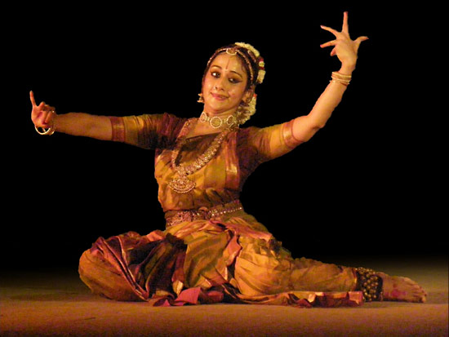
KUCHIPUDI
Kuchipudi, one of six classical dance styles
of India. Kuchipudi is indigenous to the
state of Andhra Pradesh and differs from
the other five classical styles by the
inclusion of singing.
History:
Kuchipudi originated in the 17th century with
the creation by Sidhyendra Yogi of the dance-
drama Bhama Kalapam, a story
of Satyabhāma, the charming but jealous wife
of the god Krishna.

Slide 17
COSTUMES & MAKEUP:
The traditional Kuchipudi was performed by all males troupe. A dancer in a male role would be in Angivastra, also known as Bagalbandi, wear a dhoti (a single pleated piece of cloth hanging down from the waist).A dancer in a female role would wear a Sari with light makeup.
Modern productions retain the male dress, but are more elaborate and Bharatanatyam-like for the female roles. Women artists wear a brilliantly colourful Sari (or a body fitting dress) with a pleated fan stitched in front to help highlight the exacting footwork.The end of the wrapped Sari is held fast under a light metallic (golden or brass) belt at waist. A Kuchipudi artist braids her hair somewhat differently than a Bharatanatyam artist, to reflect the regional traditions, yet wearing flowers are common. Both have symbolic elements embedded in their hair and face jewelry, such as the Vedic symbolisms for the sun and the moon, the soul and the nature, and she sometimes sets her hairdo in the tribhuvana style which represents the three worlds.Her jewelry may include hair jewelry, ear, nose, armlets, necklaces and often a leather anklet piece with little bells (ghungroo).The forehead has a round red bindi or a symmetric tillaka, while the eyes are typically ringed with black collyrium to ease the viewing of expressions by the audience

Slide 18
EDUCATIONAL IMPLICATIONS
Dance to communicate
Dance to develop skills
Dance to create
Dance to relieve stress
Dance to focus
Dance for the future

Slide 19
REFERENCES
www.holidify.com
www.britannica.com

